Slide 1


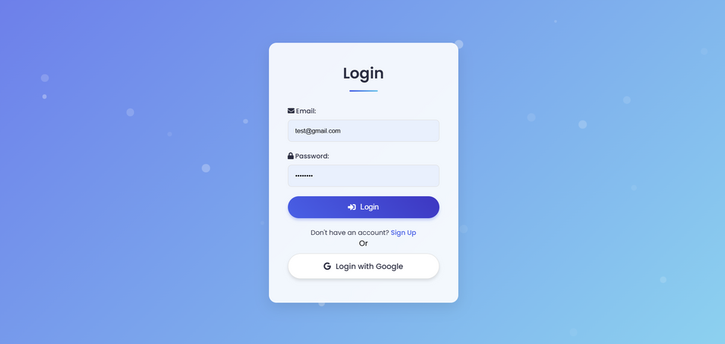
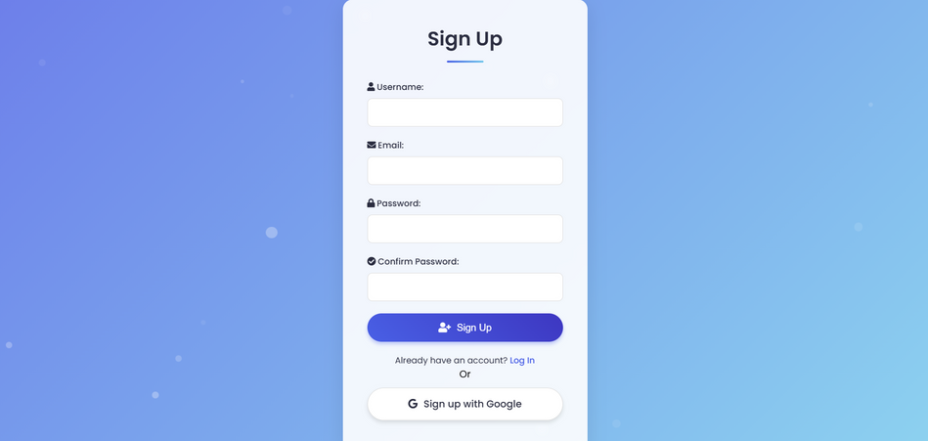
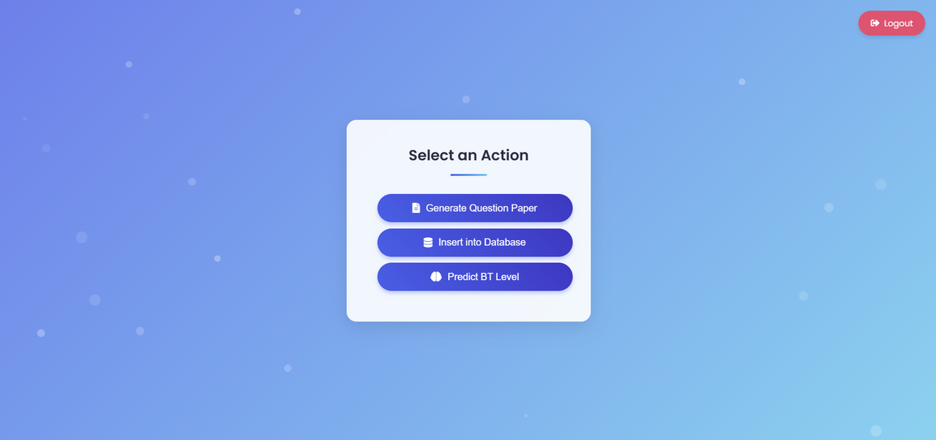
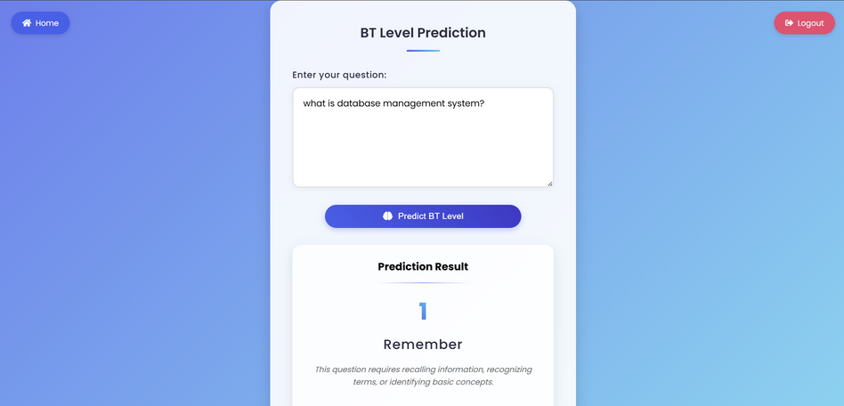
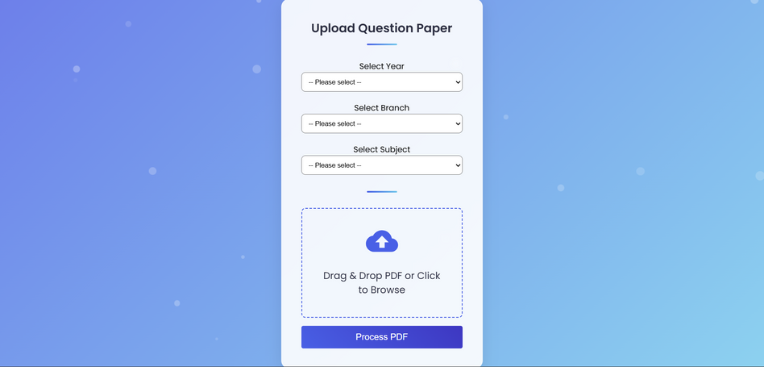
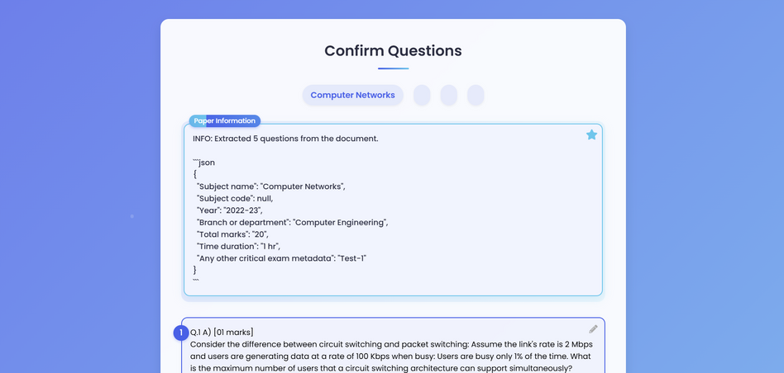
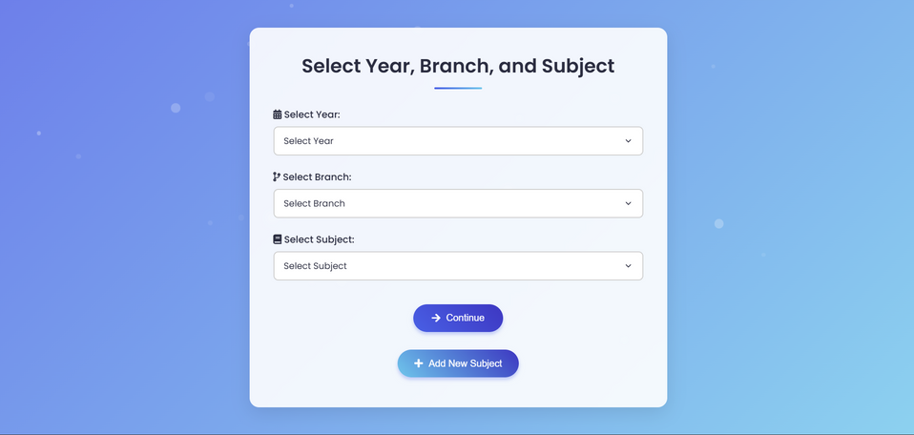
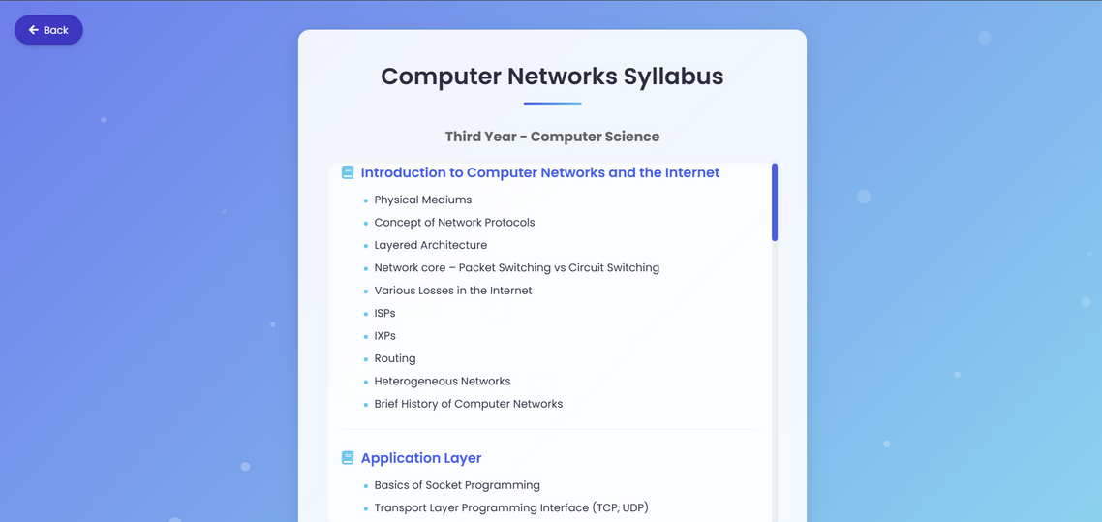
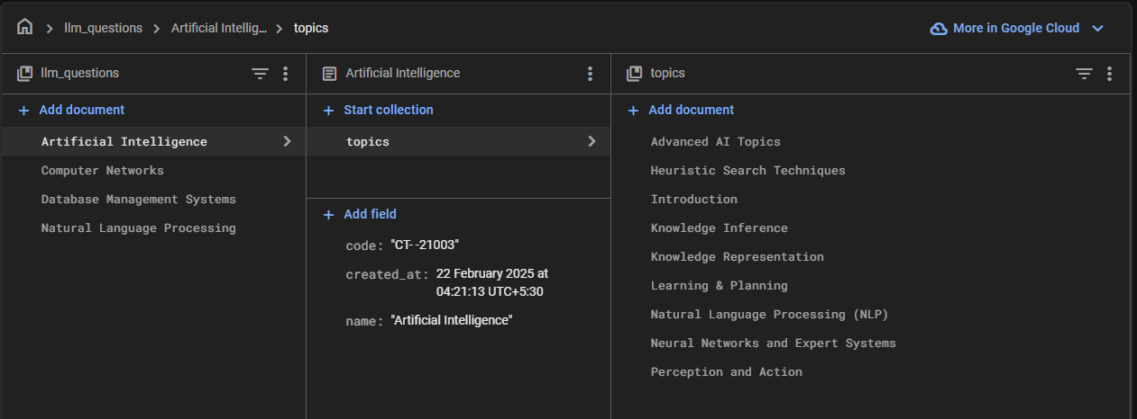
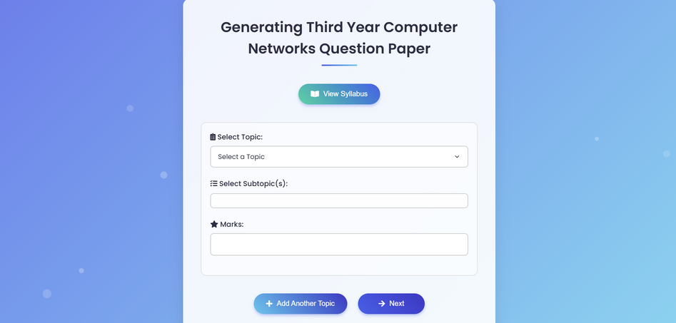
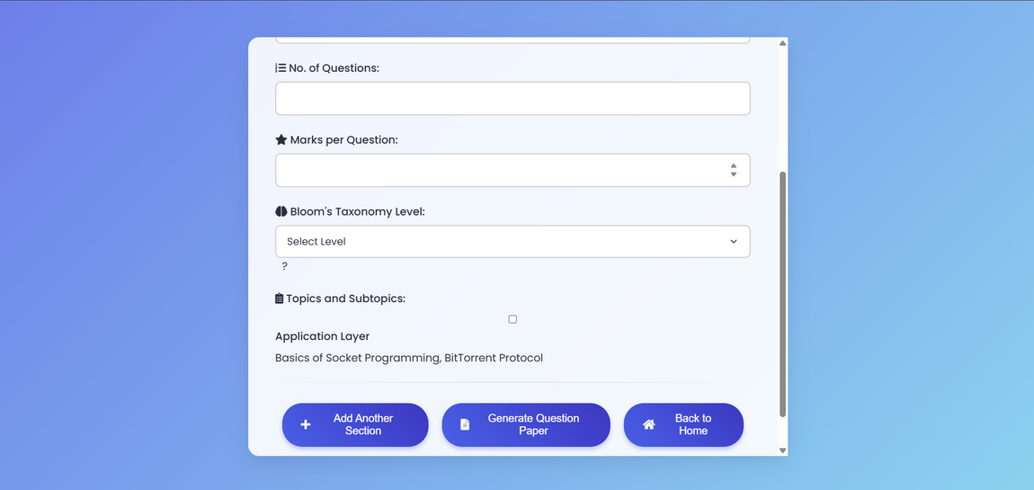
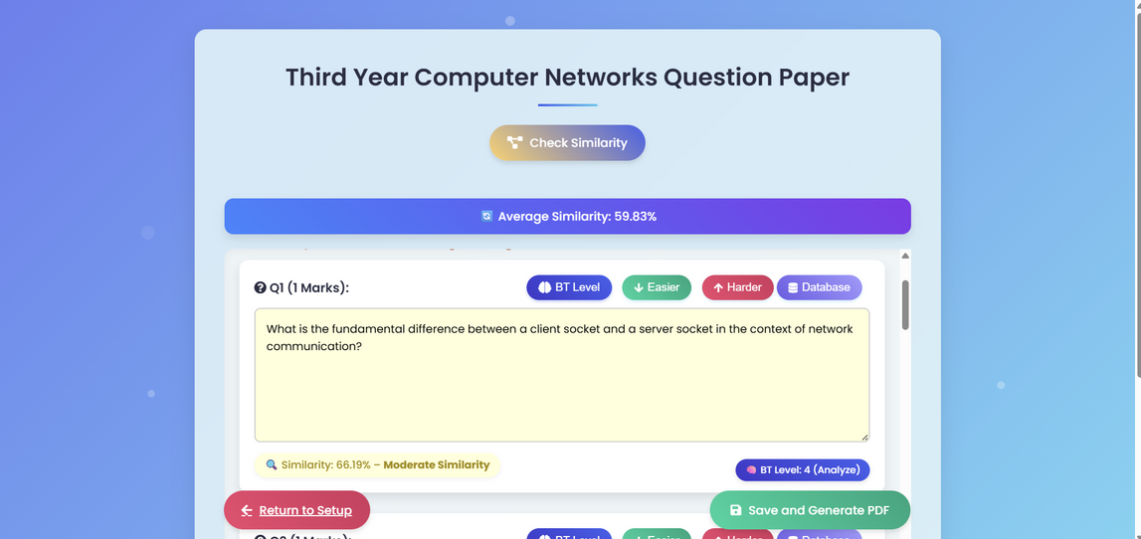
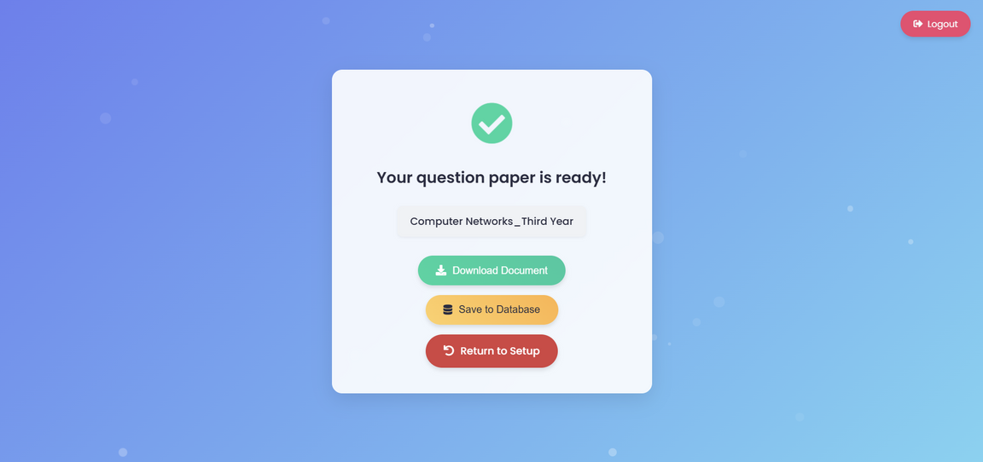
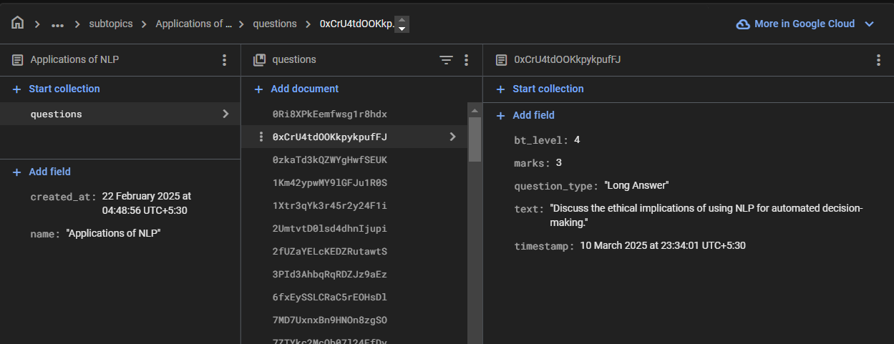
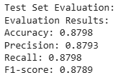
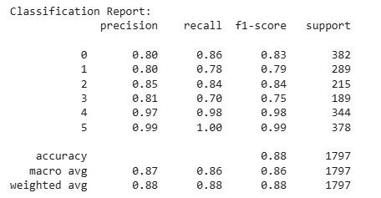
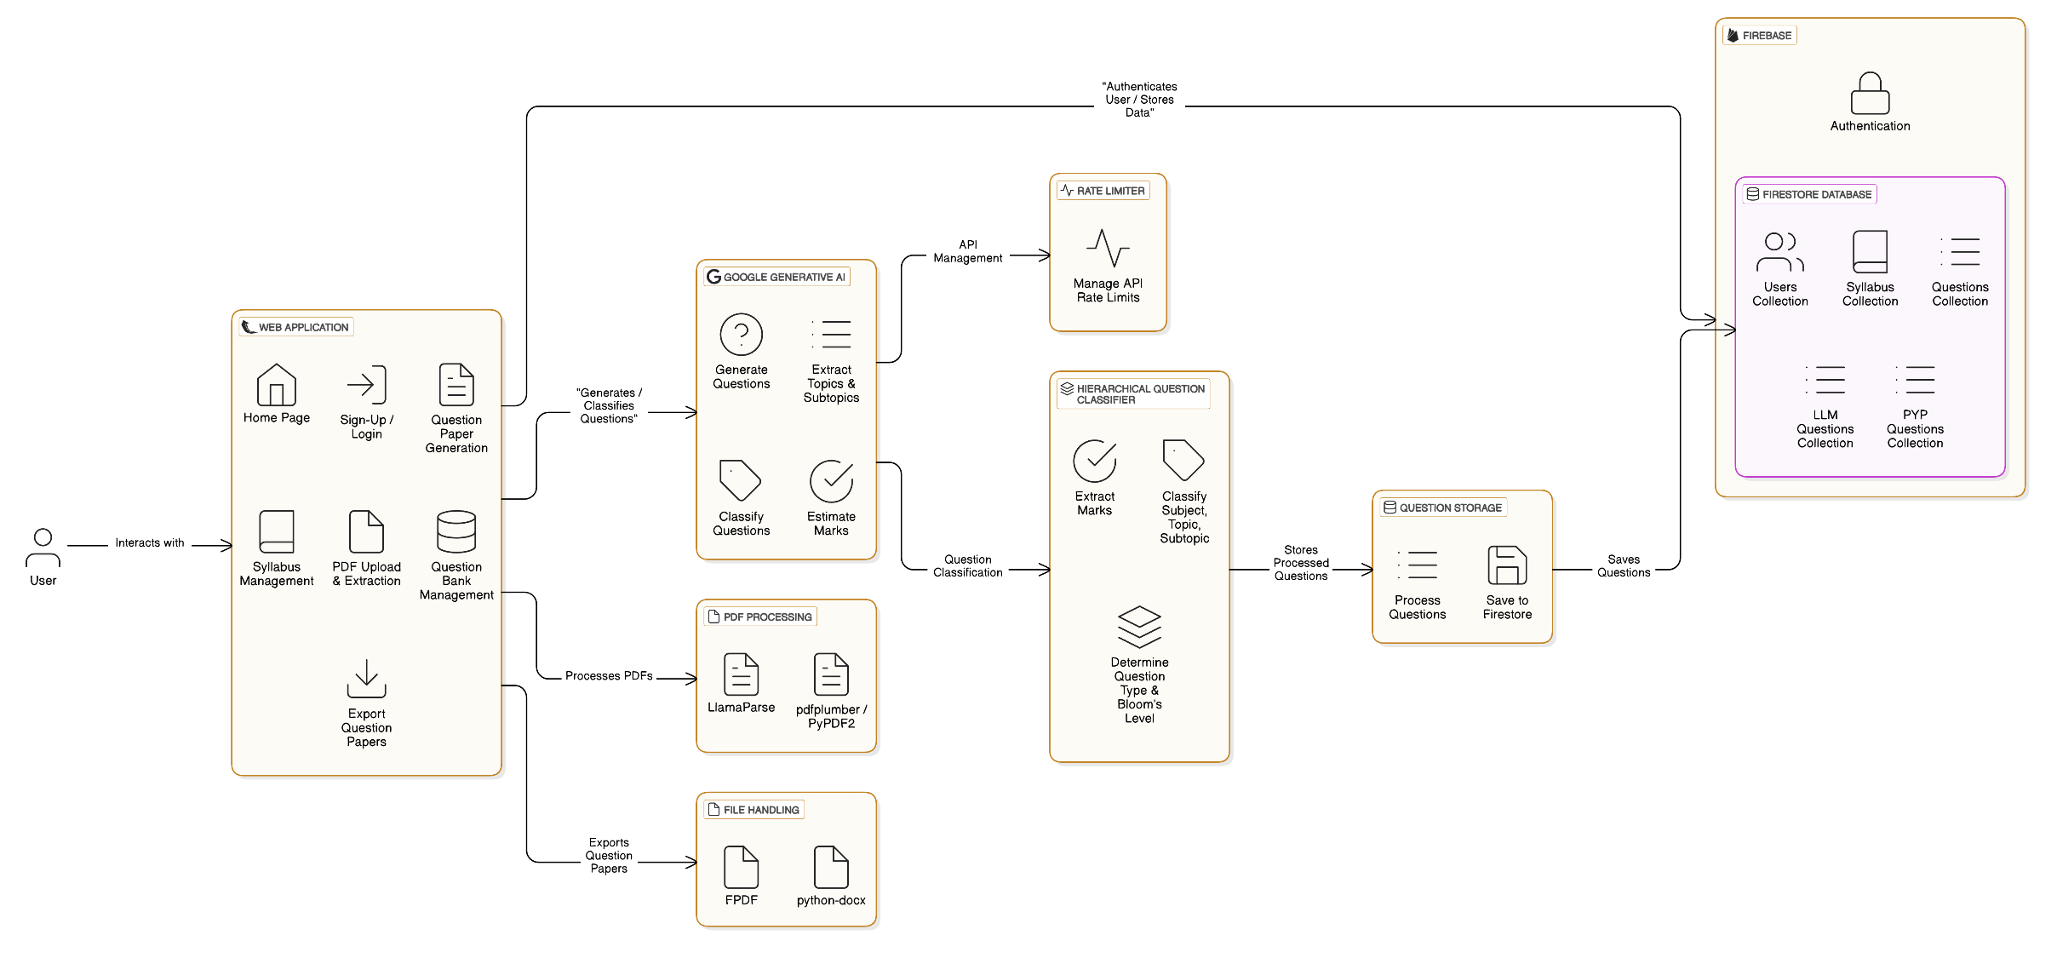
AI and Robotics
AI-Powered Question Paper Generation Based on Bloom’s Taxonomy
* SYMPOSIUM **
2024
Yash Bongirwar (112103026), Yash Diwane (112103038), Devanshu Gupta (!12103035)
Dr. Y.V.Haribhakta (College Guide)
Aim
Modules:
Smart Extraction (PDFs → DB)
Question Generation (LLM)
Validation & Bloom Classification
Similarity Check
Export + UI
Backend: Flask Frontend: HTML + CSS + Bootstrap Database: Firebase Firestore APIs: Gemini, Firebase Auth, LlamaParse Languages: Python, JavaScript
To automate the generation of customized, high-quality question papers aligned with Bloom’s Taxonomy using AI models, cloud storage, and real-time user inputs
Objective
Dataset Generation
Demo
Extract and store questions hierarchically (Subject → Topic → Subtopic).
Generate Bloom-aligned questions using Google Gemini.
Classify Bloom level using fine-tuned DeBERTa model.
Detect similarity using sentence embeddings.
Export papers in PDF, DOCX, TXT formats.
Source: Previous Year Papers (PDFs)
Tools: LlamaParse + OCR + regex cleaning
Structure: Stored in Firestore (subject > topic > subtopic)
Introduction
Manual question paper creation is time-consuming and inconsistent. Our system streamlines this with AI to ensure:
Bloom-level compliance
Reduced repetition
Customization and scalability
Results
Related Work
88% F1-score for Bloom classification
High-quality, balanced papers
Educator feedback: Useful, time-saving
Semantic similarity detection reduces duplication
Prior work used BERT, rule-based systems.
Few real-world deployable AQG systems exist.
This system integrates prompt-tuned Gemini + classification + similarity detection.
Fig: Firestore heirerchial database structure
Conclusion
Achieved end-to-end automation from input to export.
Balanced Bloom levels.
Future scope: Adaptive learning, AI-based grading, multilingual support.
Transformer Architecture
Architecture
Question Generator: Google Gemini (Prompt-tuned)
Classifier: deberta-v3-base fine-tuned on 11,976 questions
Similarity: all-mpnet-base-v2 → cosine comparison
References
[1] A. Vaswani, N. Shazeer, N. Parmar, J. Uszkoreit, L. Jones, A.N. Gomez, Ł. Kaiser, and I. Polosukhin, ”Attention is All You Need,” in Advances in Neural Information Processing Systems, vol. 30, 2017.
[2] J. Devlin, M. Chang, K. Lee, and K. Toutanova, ”BERT: Pre-training of Deep Bidirectional Transformers for Language Understanding,” arXiv preprint arXiv:1810.04805, 2018.
[3] P. He, X. Liu, J. Gao, and W. Chen, ”DeBERTa: Decoding-enhanced BERT with Disentangled Attention,” arXiv preprint arXiv:2006.03654, 2020.
[4] B. S. Bloom, M. D. Engelhart, E. J. Furst, W. H. Hill, and D. R. Krathwohl, Taxonomy of Educational Objectives: The Classification of Educational Goals, Handbook I: Cognitive Domain, David McKay Company, 1956[5] D. R. Krathwohl, ”A Revision of Bloom’s Taxonomy: An Overview,” Theory into Practice, vol. 41, no. 4, pp. 212–218, 2002.
[6] N. Scaria, S. D. Chenna, and D. Subramani, ”Automated Educa tional Question Generation at Different Bloom’s Skill Levels Using Large Language Models: Strategies and Evaluation,” arXiv preprint arXiv:2304.12345, 2023.
Implementation
Department of Manufacturing Engineering and Industrial Management, College of Engineering Pune

